Slide 1
TEDI project (Trans European Drug Information)
Berlin, 9th of November 2017
Mireia Ventura PhD
TEDI manager

Slide 2
Definition
The term “Drug Checking” (DC) refers to an integrated service that basically enables drug users to have their drugs bought on the grey or black market (e.g., cocaine, ecstasy, GHB, or LSD) chemically analysed as well as to receive advices and - if necessary - consultation and counseling.
Other terms as are used: Drug Testing, Pill Testing, Testing, Pill Checking.
TEDI propose as standard the name of Drug Checking

Slide 3
Drug Checking in Europe
In TEDI were included seven European countries offering Drug Checking facilities that generate around 14.000 samples every year.

Slide 4
Definition TEDI project
The Trans European Drug Information project (TEDI) is a network of European fieldwork Drug Checking services that share their expertise and data within a European monitoring and information system.
TEDI’s chief aim is to improve public health and intervention programs, improving the knowledge, the diffusion and the best practices of the all groups of drug checking.
TEDI has developed a database system that collects, monitors and analyses the evolution of various European drug trends in recreational settings.

Slide 5
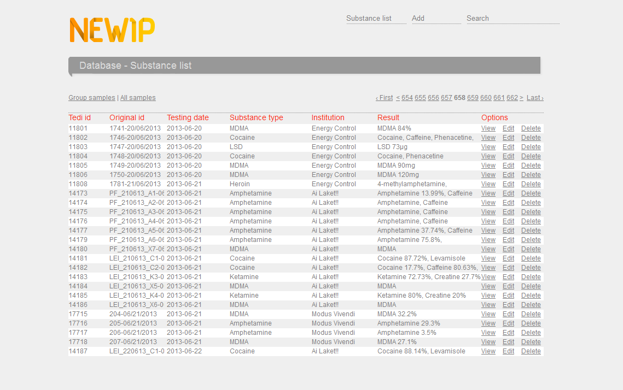
TEDI’s database
16.449 samples from 5 different groups working in the field with Drug Checking
458 different substances inside TEDI’s database
210 synthetic drugs inside

Slide 6
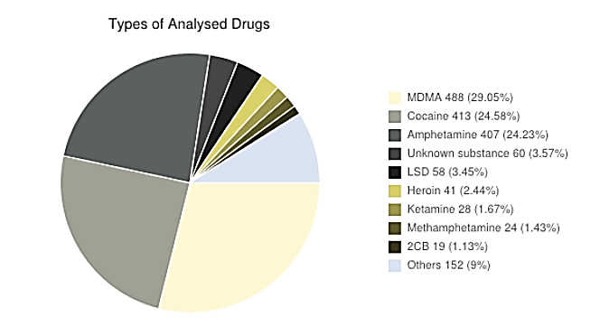
TEDI’s database

Slide 7
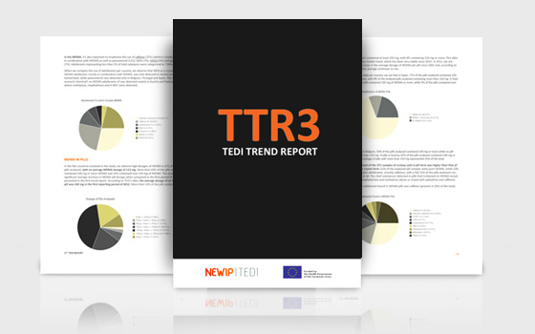
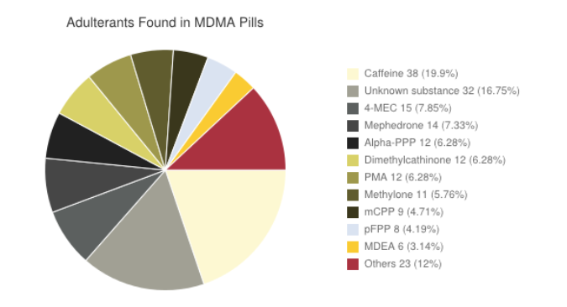
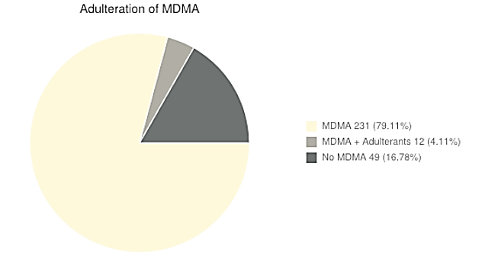
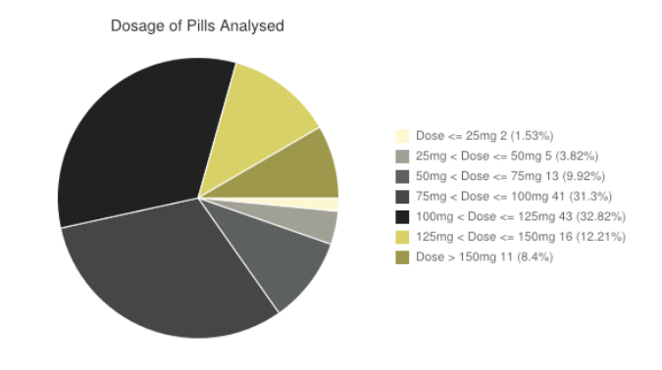
TEDI’s Trend Reports (TTR)
1st TTR: July 2012
2nd TTR: January 2013
3rd TTR: August 2013

Slide 8
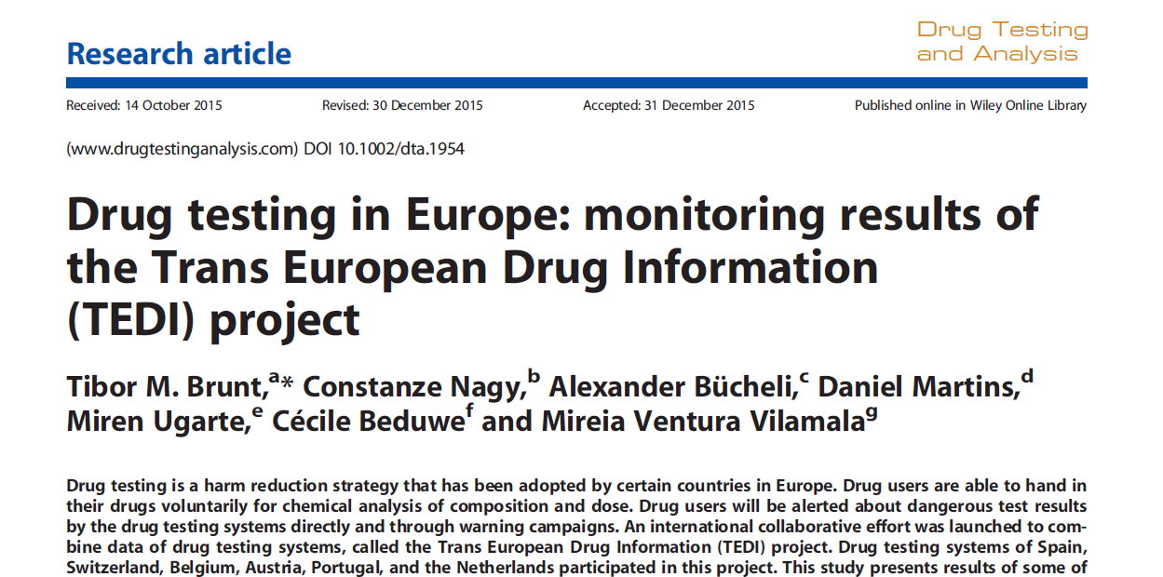
Scientific article of TEDI project

Slide 9
Type of drugs analysed by TEDI members (2008-2013)

Slide 10
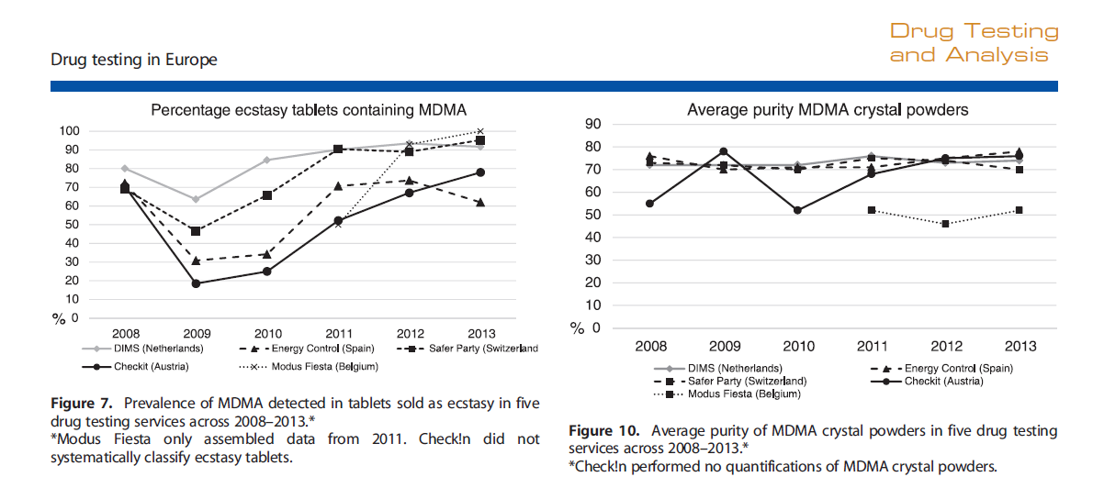
Evolution of MDMA (2008-2013)

Slide 11
Evolution of cocaine and amphetamine (2008-2013)

Slide 12
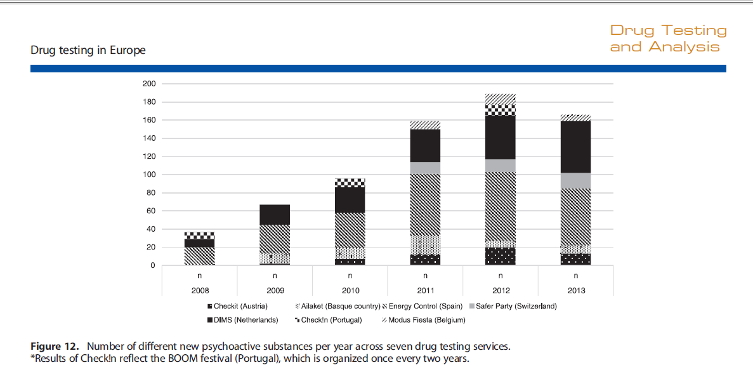
Scientific article of TEDI project
60 NPS detected were new for TEDI members during these 3 years of project

Slide 13
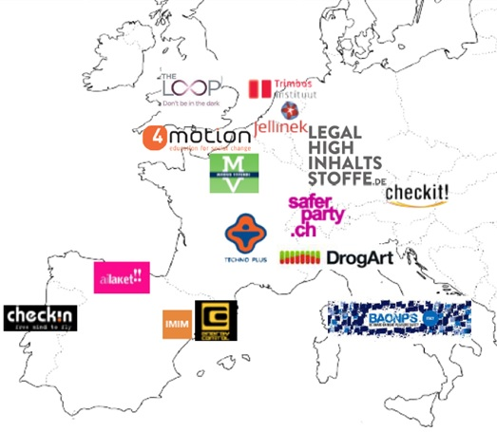
New European Drug Checking services are appearing…

Slide 14
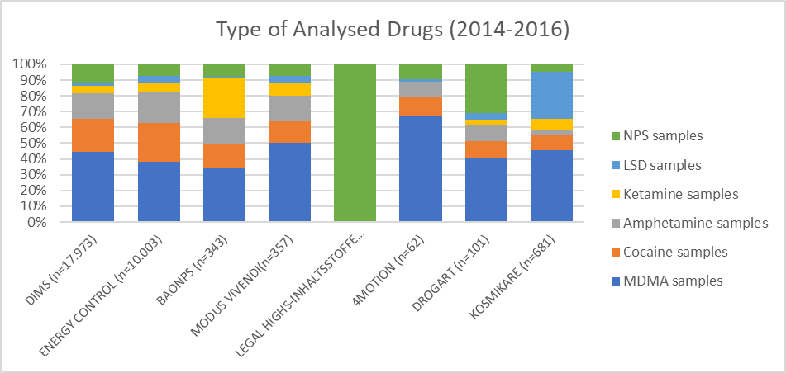
Type of drugs analysed from 2014 to 2016

Slide 15
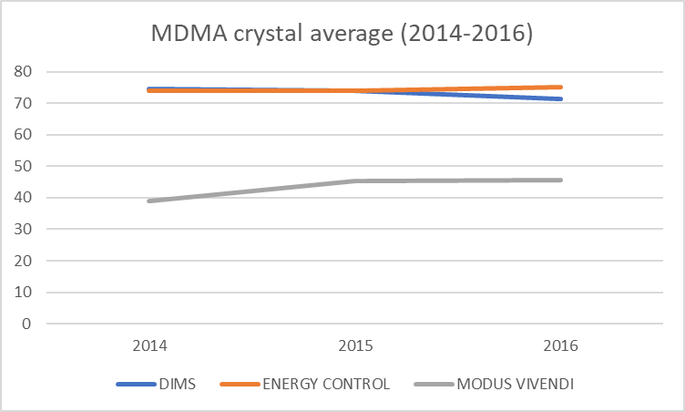
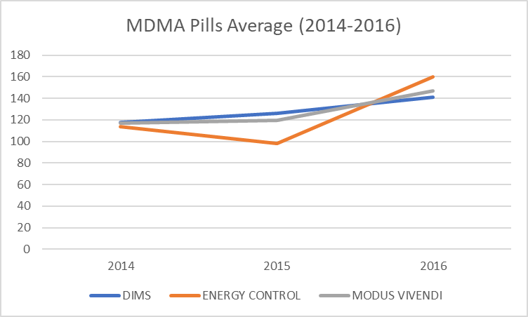
Analysis of MDMA 2014-2016

Slide 16
TRENDS IN NPS
There is an increasing trend of NPS used as an adulterant in classic drugs
10% of samples (DIMS 2016)
Powerful substances such as alpha-PVP (EC 2017)
Increase in variety of NPS detected
LEGAL HIGH INHALTSSTOFFE (2016)
9 designer Benzodiazepines
12 synthetic Opioids
In herbal mixtures most relevant ingredient is CUMYL-PeGACLONE

Slide 17
THANKS FOR YOUR ATTENTION!
www.safernightlife.org/tedi
mireia@energycontrol.org

