Slide 1
Online training for festival crew: the Belgian experience
Jochen Schrooten
Coordinator Quality Nights Flanders
Notes:
Training staff and crew in recreational settings is an important interventions to reduce risks and nuissance. Within the confines of the Quality Nights label for clubs and events in Flanders (Belgium), we developed an online training module for crew that is integrated in an online learning management system (LMS: www.Docebo.com). This online training module makes it possible to inform the crew before the festival starts about the implementation of different health services at the event and improves knowledge and attitudes of festival crew in preventing drunkenness and other health related problems. The LMS provides us real time info on the learning path of all the crew members and provides those who passed the test with a certificate.
The e-learning module was developed in cooperation with local dance event promotors and local prevention workers and will be tested in a few dance events in May and June 2015. During the Stad nach acht conference we will present some results of our experience with this intervention alongside some of the most interesting features of the docebo platform.

Slide 2
Quality Nights Charter
Club / dance event
Local & regional partner(s)
VAD / Modus

Slide 3
62
12
4
13
2QE
3QE
2QE
3
3
2QE
3QE
15
1
3
4
6
2QE
4
3
3
Notes:
In totaal zijn er meer dan 70 QN locaties waarvan meer dan 30 in Vlaanderen. Er zijn 12 QN events waarvan 10 in Vlaanderen.

Slide 4
+2.0000.000 visitors

Slide 5
Services

Slide 6
Events
50% crew / every year
30 minutes
Quality Nights
RBS
Clubs
50% staff / 2 years
6 hour training
First aid
Conflict management
RBS
Notes:
management is involved,

Slide 7
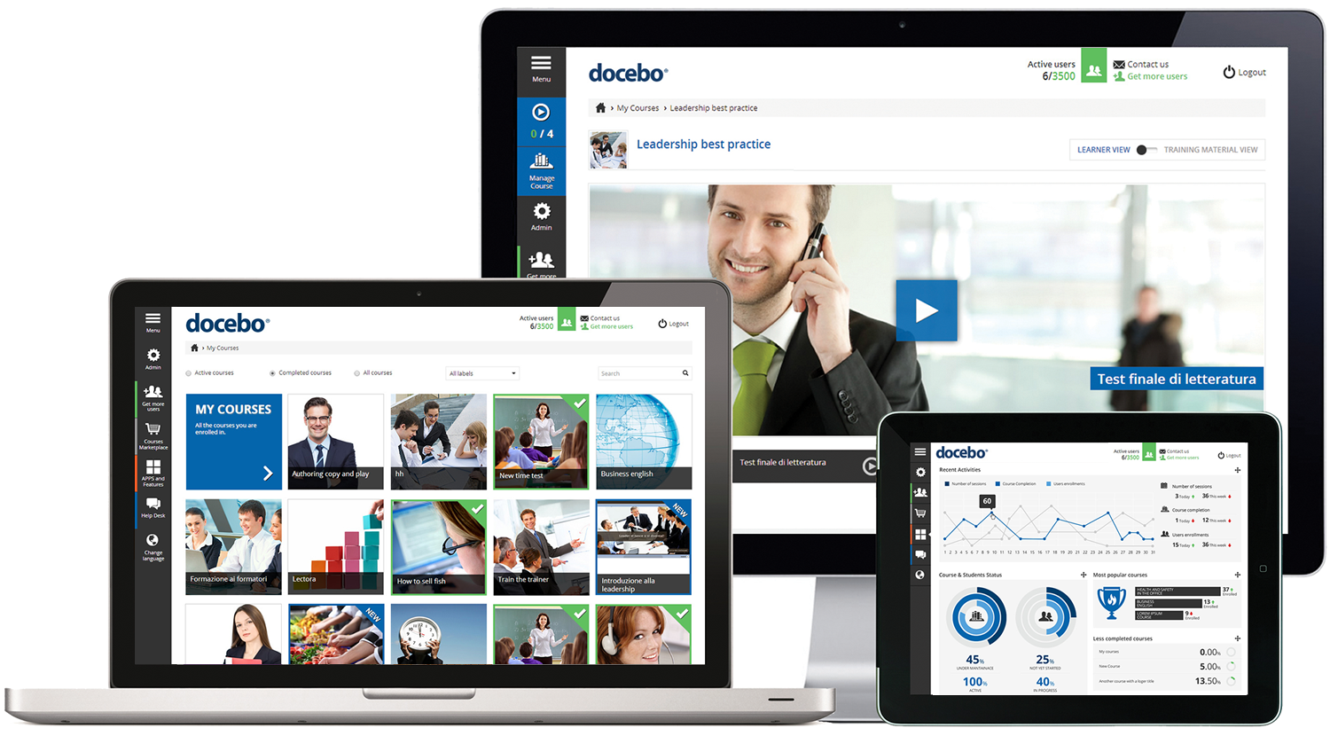
Docebo
Learning Management System
Simple
Responsive
Nice design
Good reports
Free trial
5€ / trainee
Notes:
Jochen.schrooten@vad.be
L1nekejochen
https://www.youtube.com/watch?v=UMAqLShre2c

Slide 8
Invitation by email
Notes:
Jochen.schrooten@vad.be
L1nekejochen
https://www.youtube.com/watch?v=UMAqLShre2c

Slide 16
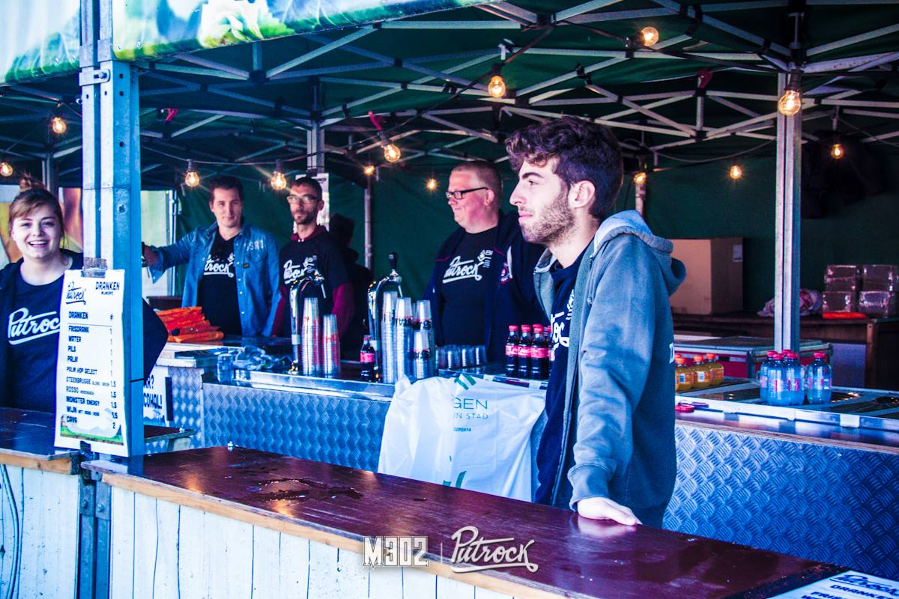
Succes
Accepted well
Train large groups
1647 trained

Slide 17
Challenges
Engagement
Priority
Follow up training
Notes:
Challenge:
Priority!
Keep the festival engaged.
- Follow up trainings?

Slide 19
Conclusions
Training staff & crew is important
Festival crew difficult to train
Docebo LMS fits our needs (simple, design, reports, price…)
Ability to train large groups of crew
Participation rate is high
⬇ Length of training seems ok
⬇ Knowledge: high test scores, interested
Price: 5€/trainee (12OO crew)
Disadvantage: only year plan

Slide 20
Evaluation results
Lenght of training
3% short
73% ok
24% long

Slide 21
Evaluation results
Learning proces
57% knowledge
43% not new

