Slide 1
How to deal with harm reduction without being prosecuted?
THE INCREDIBLE ADVENTURES OF DOCTORX IN DEEP WEB
DR. FERNANDO CAUDEVILLA
FAMILY PHYSICIAN. ENERGY CONTROL (ABD).SPAIN
NIGHTS 2017. STADT NACH ACHT. BERLIN 9/11/17

Slide 2
Volunteer work
Night
Drug- checking
Infoline
Inclussion, support, training
Work groups
Stands
Safer night
In-situ
Thin Layer Cromatography
GC-MS
Web+phorum
E-mail
Telephone (902 253 600)
Offices
Social webs
International, media and research
Educational center action
Teenagers
Parents
Teachers
Town council advice
Notes:
Energy Control is a risk reduction project in Spain, working since 1999 that provides:
INFORMATION
ASSESSMENT
DRUG TESTING
for drug users.
We mainly address YOUNG PEOPLE who do recreational drug uses.
Based on PEER TO PEER WORK and OUTREACH ACTIVITIES we manage to be in direct contact with them.
We have several fields of work
Most of our work is SUPPORTED by VOLUNTEER WORK, although financed by EUROPEAN, NATIONAL and LOCAL authorities

Slide 3
ON-LINE HEALTH & DRUGS ADVICE IN HARM REDUCTION
E-mail lists
Public
Forum
Chat
Virtual
Reality
Private
E-mail
Social
Networks
Videoconference
POSITIVE ASPECTS
Guarantees confidentiality
Highly accesible
Not expensive
Give concrete answers
NEGATIVE ASPECTS
Limited information
Difficulties for communication
Possible interpretational errors
Inadequate in some situations

Slide 4
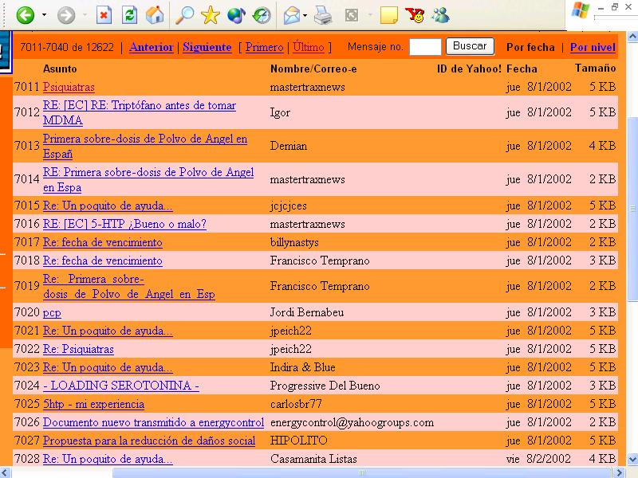

Slide 5
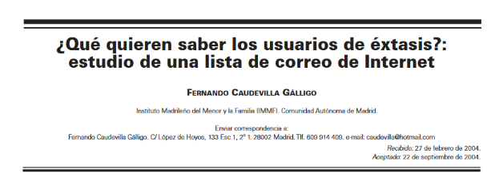
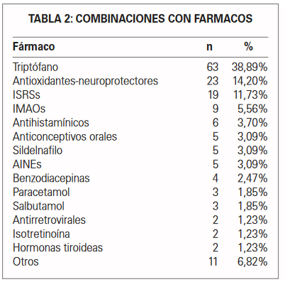
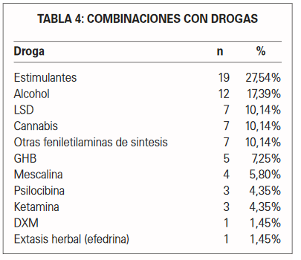
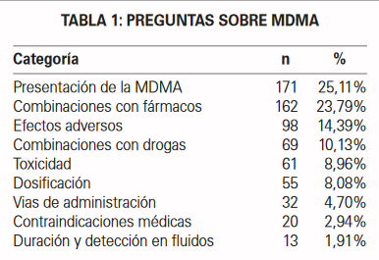

Slide 6
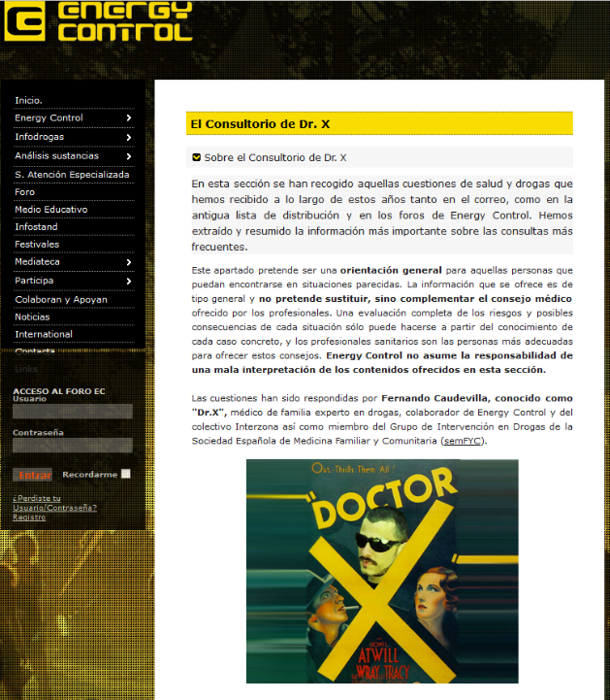
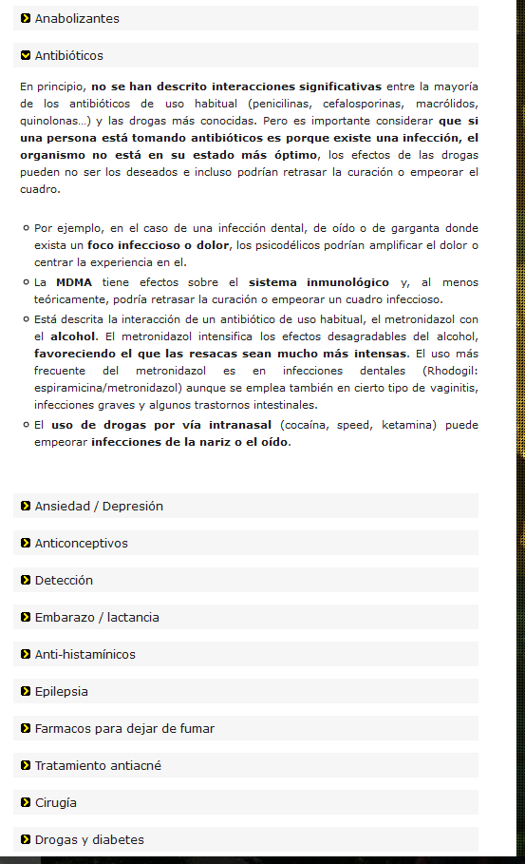

Slide 7
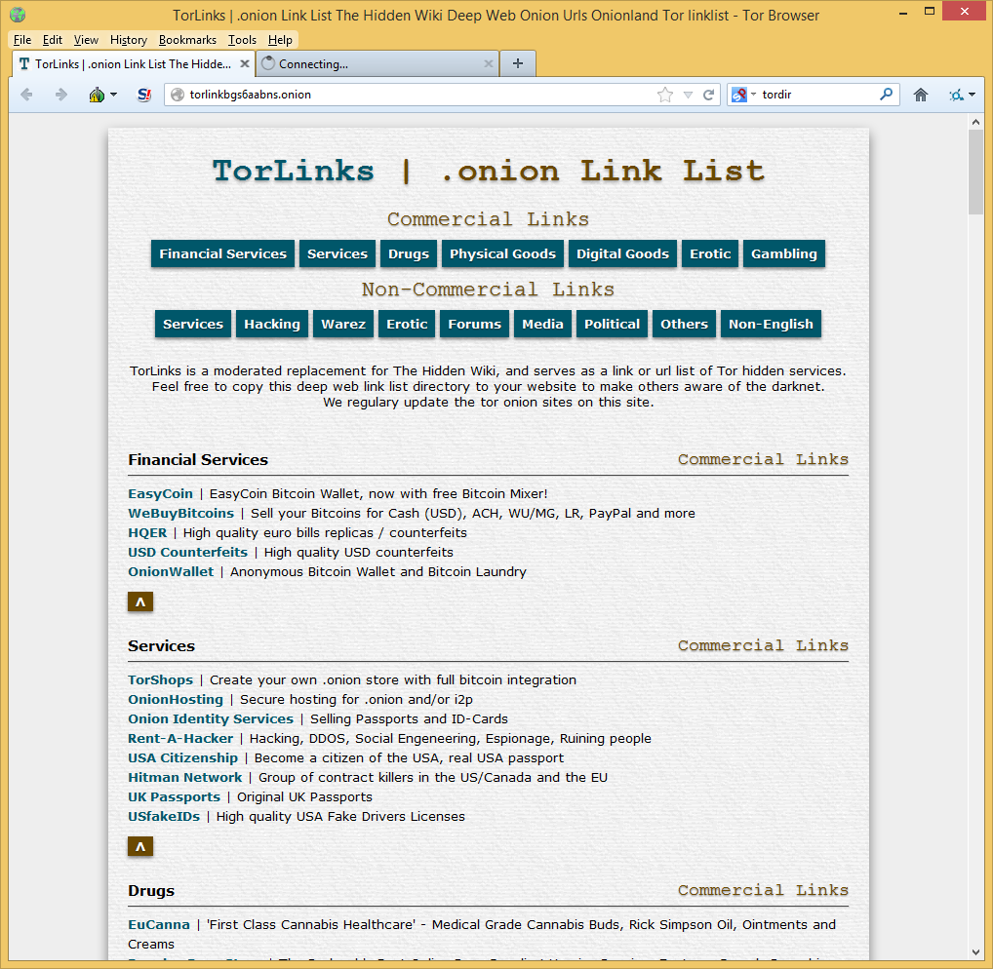
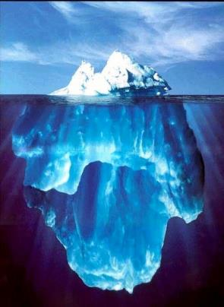

Slide 8
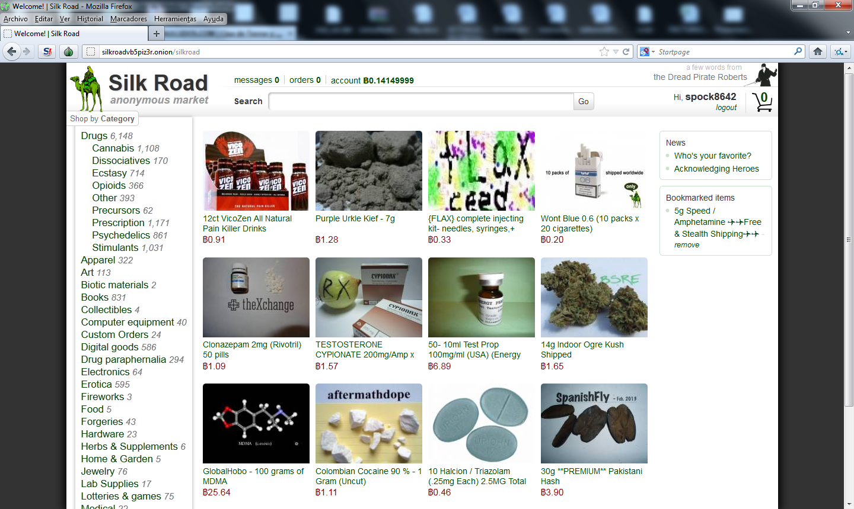

Slide 9
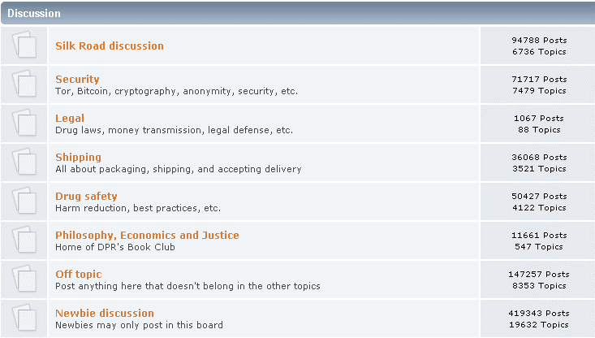
Silk Road forum. URL available in: http://web.archive.org/web/20131015051031/https://dkn255hz262ypmii.onion.to/index.php
Access: 23/10/14
Notes:
This is a screen capture of the Original Silk Road Forum, that was active until the seizure of Silk Road in October 2013.
It was a HUGE forum with more than TWO HUNDRED THOUSAND posts ,THIRTY THOUSAND topics, classified in 12 SECTIONS, with TENS OF THOUSANDS of active users and HUNDREDS of messages every day.
I realized that there was a “Drug Safety” subsection and I decided to start a thread offering scientific information about drugs in a risk reduction perspective, and oriented to drug users

Slide 10
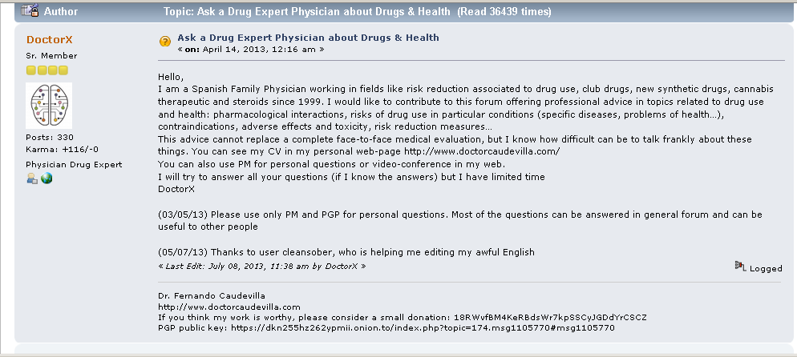
Notes:
So this is the post where I introduced myself.
Most of the persons who have posted in Deep Web forums are anonymous but I decided to use my real identity and my web page , in order to gain credibilityas I had nothing to hide and I was not involved in illegal activities.
I also offered a BTC address to accept free donations for my work. I will comment about this later

Slide 11
Notes:
During the 7 months period I was posting in SR forum I received more than 400 different questions (most of them public, but also as private messages). My thread received more than THIRTY SIX THOUSAND visits during this period.
DoctorX thread about health and drugs was in the “top 10” of all the SR posts of the forum.

Slide 13
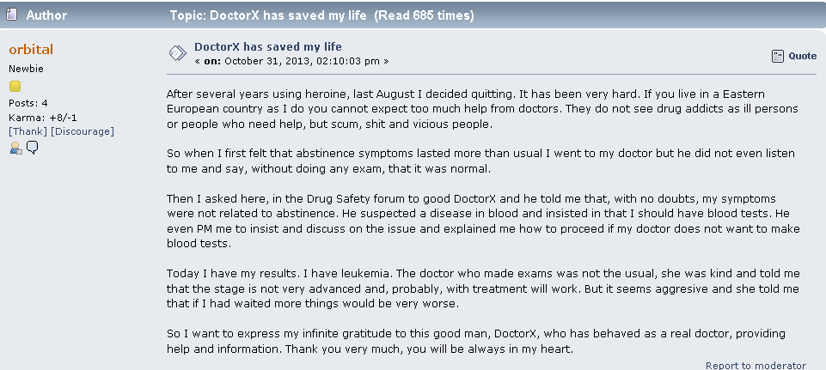
Notes:
This is another suprising case. It is a man who lived in a Eastern European country who had detoxified heroine on his own.
He had been suffering “pain in bones” and fever during night for 1 month. He had been told that these were symptoms of abstinence (he says “the doctor did not even listened to me, he said that everythings was normal without doing any exam”)
“Night fever” is not a symptom of abstinence but can indicate different haematological problems, in this case I insisted in the necessity of doing blood test, than finally revealed a leukaemia

Slide 14
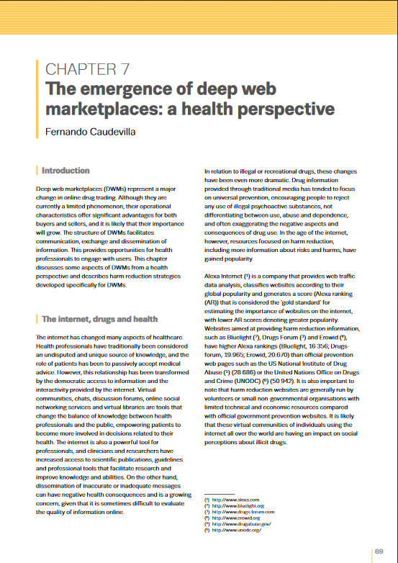

Slide 15
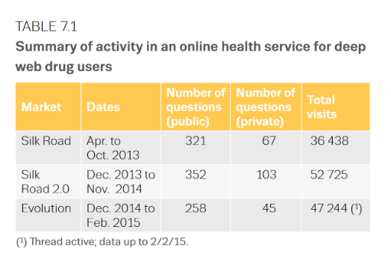
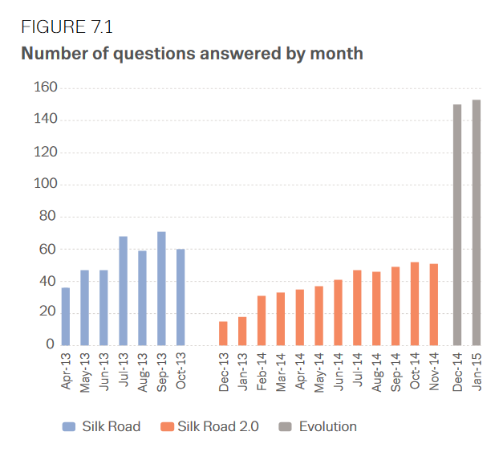
Caudevilla, F. (2016). The emergence of deep web marketplaces: a health perspective. In European Monitoring Centre for Drugs and Drug Addiction (Ed.), The internet and drug markets (EMCDDA Insights 21) (pp. 69-75). Luxembourg: Publications Office of the European Union.

Slide 16
QUESTIONS CLASSIFIED BY SUBJECT
Caudevilla F. Reducción de riesgos on-line: una experiencia en los foros de Silk Road.V Jornadas de Reducción de Riesgos de Catalunya. Barcelona, 28/11/2013
Notes:
These are the questions classified by subject

Slide 17
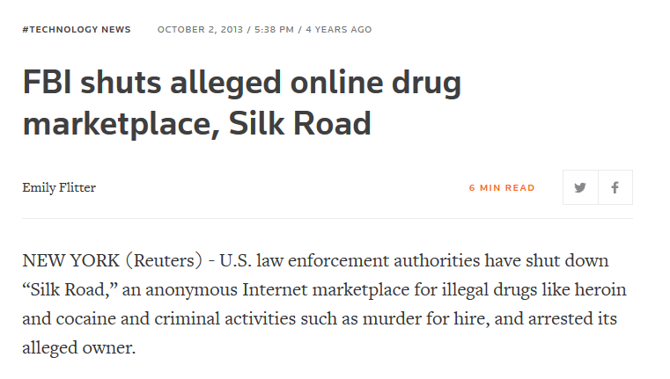
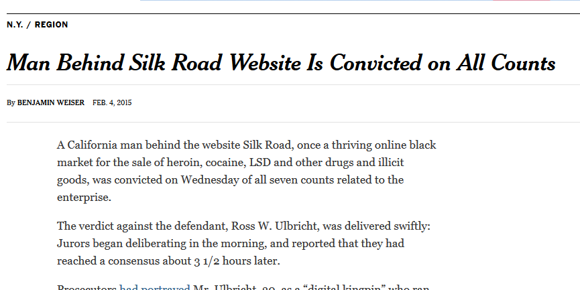

Slide 18
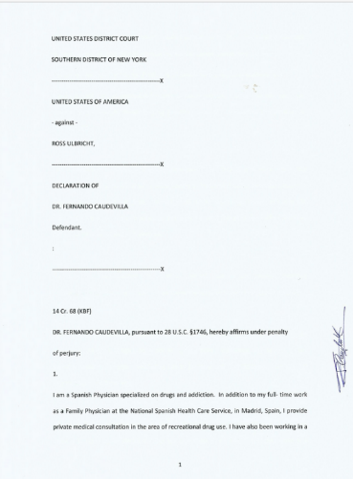
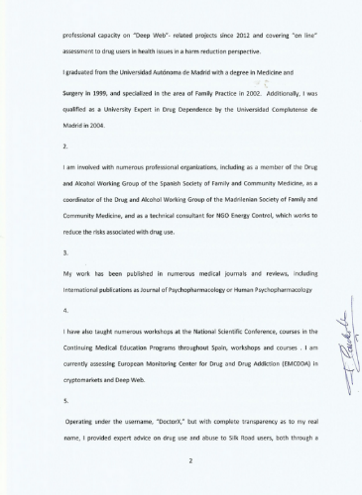
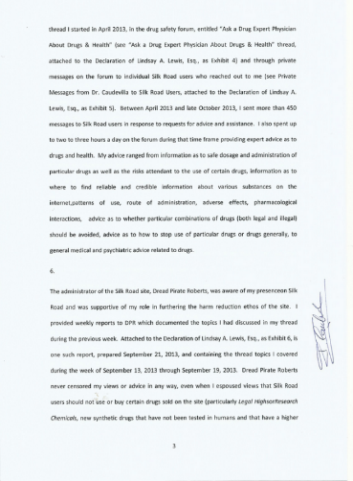

Slide 19
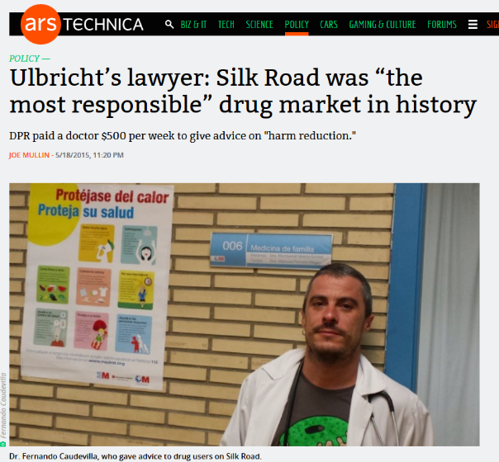

Slide 21
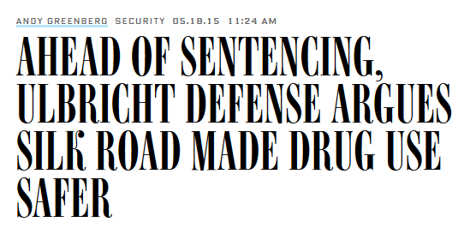

Slide 23
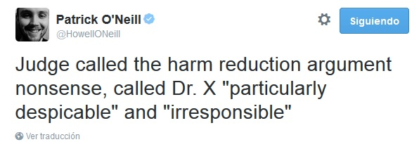

Slide 24
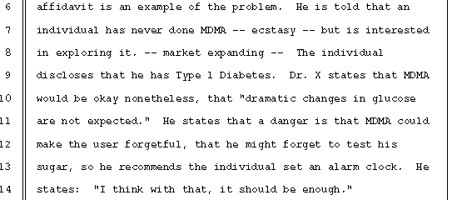
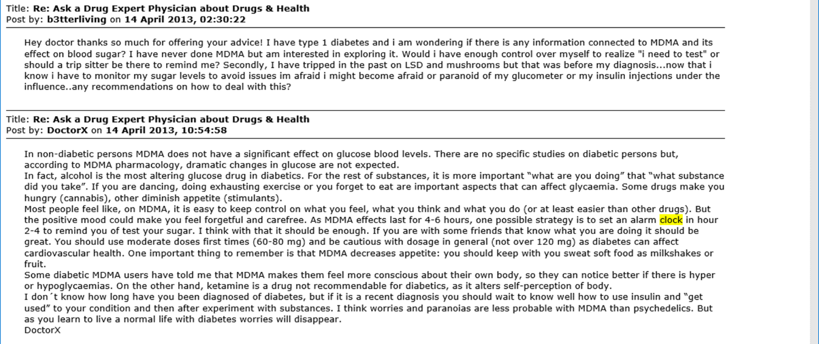

Slide 25
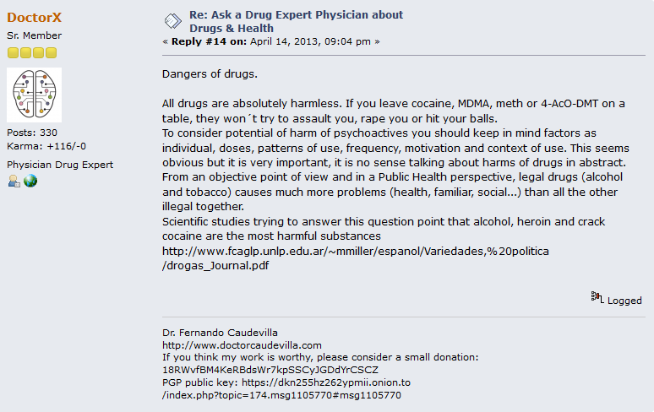
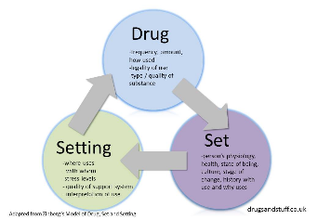
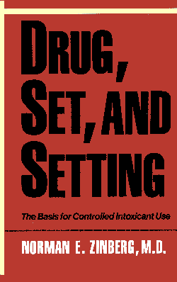

Slide 27
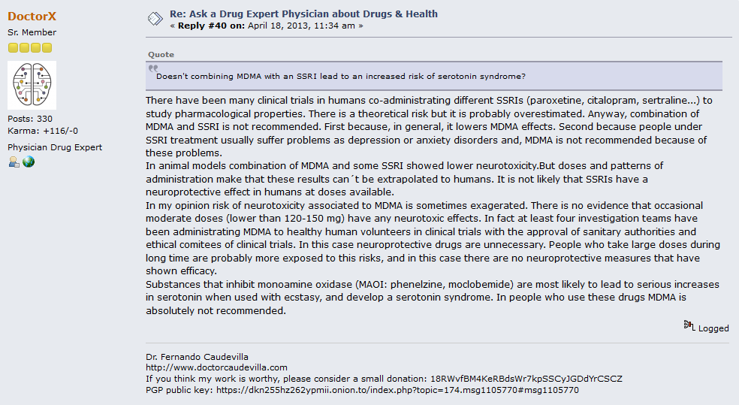
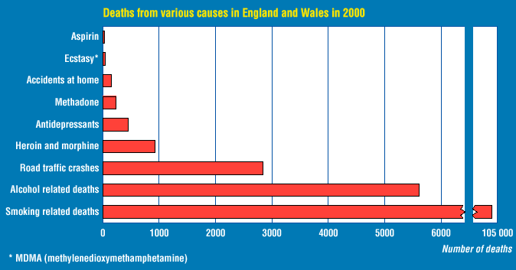
McKenna C. Ecstasy is low in league table of major causes of deaths. BMJ 2002;325:296

Slide 30
(01/16/16)
(11/12/15)
(30/10/16)

Slide 31
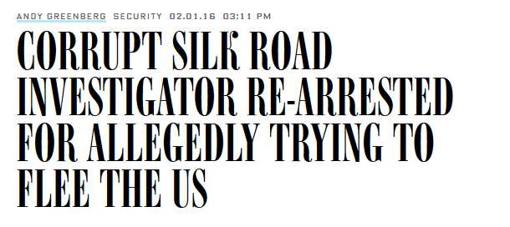
(02/01/16)
(17/08/16)
(20/10/15)

Slide 32
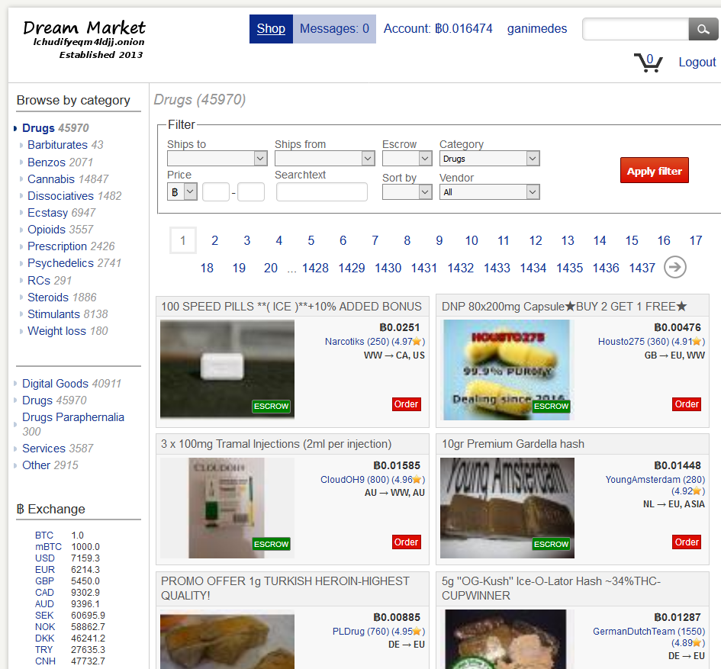

Slide 33
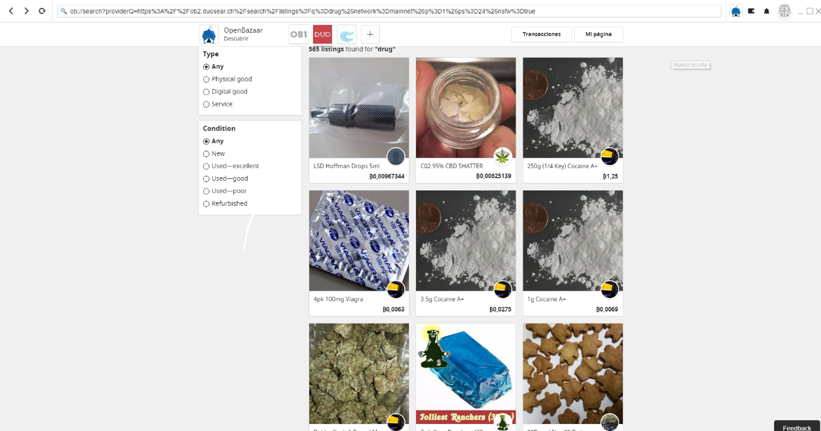

Slide 34
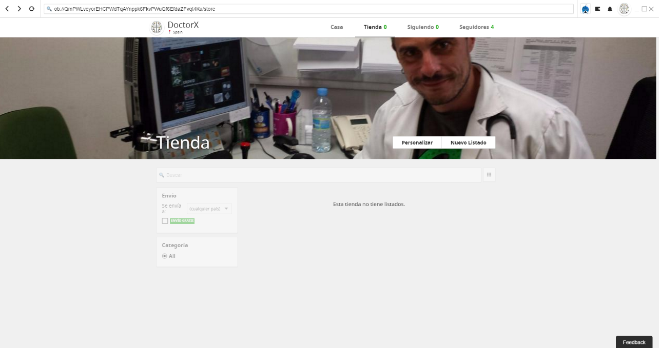

Slide 35
The end ????
This is NOT a work of fiction. Names, characters, places and incidents are NOT products of the author’s imagination. Any resemblance to actual events or locales or persons, living or dead, is, DRAMATICALLY REAL

